Slide 1
Floor Meeting Talk Outline

Slide 2
Outline
Hardware and technique developmental journey.
What is multiplexing and its perks and pros/cons of current techniques? (fiducial marks and getting back to same spot) (2 slides)
Spawning idea: Why make machine and desired features (1 slide)
Manufacturing process CAD software, parametric modeling, videos such as 3D printer in action, parts working, how they fit together, etc. ()
Overview of entire system w/ highlighted key features (ie, pinch valve fluidic system, invisi-slip microfluidic device, Arduino communication system, software, microscope itself)
Go into each highlighted key section of system in more detail.
Microscope (light path super imposed on microscope, real image next to microscope popped out from camera with real dimensions and resolution).
Software (block diagram of code and software to what controls what w/ pycromanager as the bridge and image processor)
Arduino communication system (diagram explaining how commands are transferred and the MQTT server and the circuit board w/ arduino)
Invisi-slip (perks of FEP film, issues with FEP film in manufacturing, Manufacturing pipeline for device, images with and without device)
How to make it all work
Microscope (reflectance issue, autofocus slide, auto exposure algorithm tree)
Fluidic system (peristaltic pump flow rate vs RPM, fluidic mixing front graph)
Discovery of new bleaching solution
Story of Jerry Turner giving me lead and Biotium giving reaction, show minimal results on PubMed
Alexa 488 kinetics and fit with partial fluor intermediate model
Panel kinetics w/ fits w/ comps to H2O2 and LiBH4
Side by side pics of H2O2, LiBH4 and m-CPBA bleached tissue at a fixed time.
Images in action
Look at gifs of real time stain of tissues and real time bleach of them
Aggregate images of images with all the stains

Slide 3
Multiplexing
Imaging sample with more than 4 stains
Diagram depicting steps in each process
Codex | Bleaching
Expensive, hard to make constructs | Slow bleaching process, non-user friendly software, directly conjugated antibodies
Thoroughly validated, good working commercial system | Cheap and straight forward protocols

Slide 4
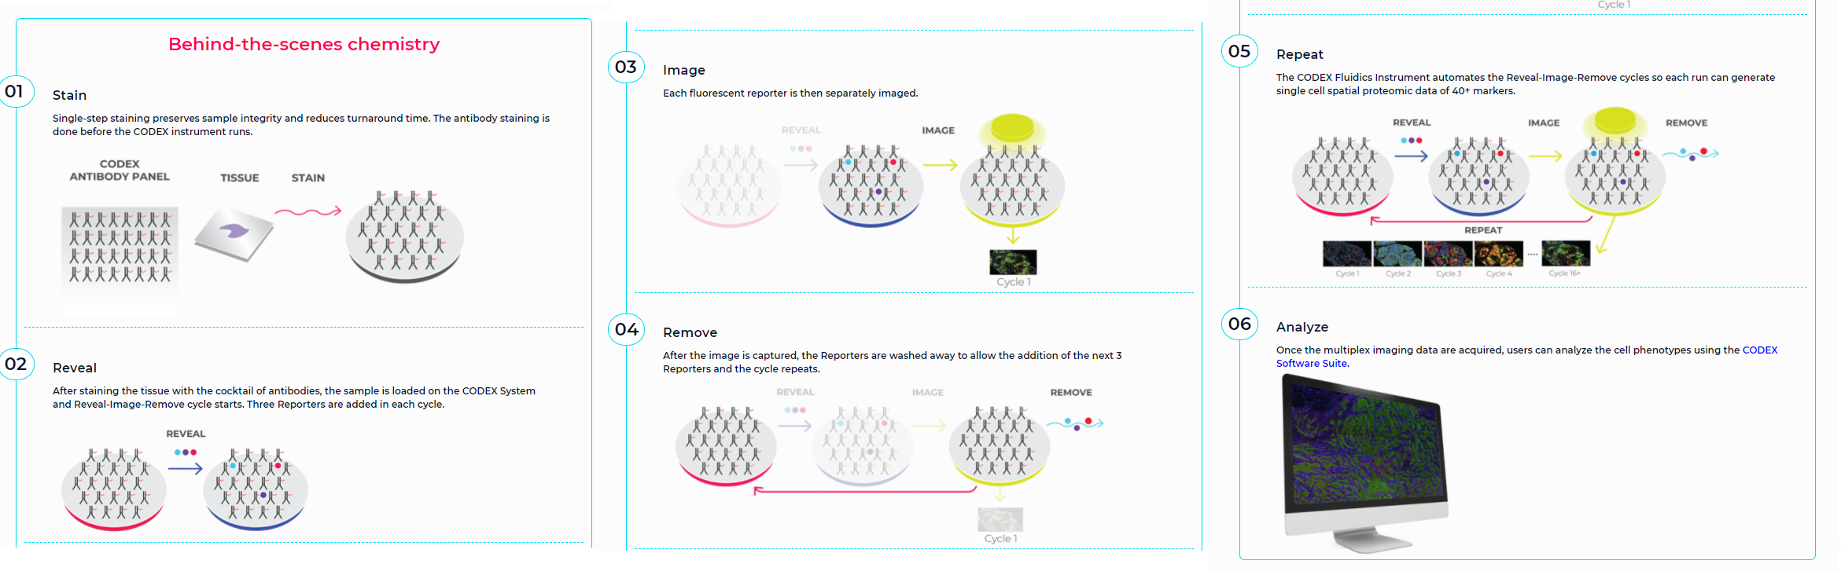
Release Flurophore/Antibody
Cyclic method of staining where either the fluorophore or primary antibody is released from the sample and then the sample is restained
Most notable example is the Codex system which uses short DNA segments as linkers between fluorophores and antibodies

Slide 5
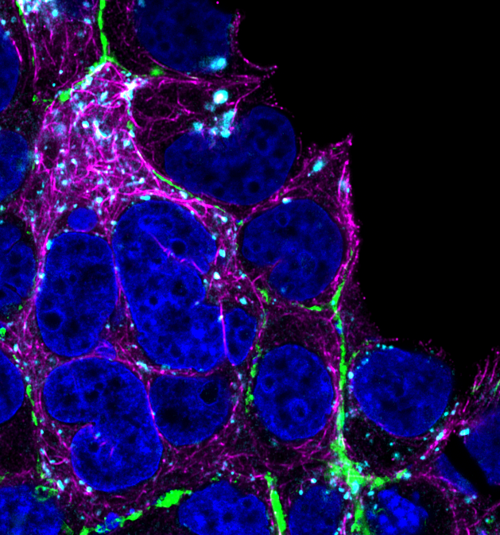

2. Location
Return
Cycle 1:
Villin
DAPI
Cycle 2:
LAMP1
Phalloidin
3. Image
1. Stain
63x
LSM 880
4. Bleach

Slide 6
CyCIF Issues
Labor barriers = long and tedious process
Cover Slipping Procedure
Remove Cover Slip via
Dipping into PBS
Stained Tissue
10% Glycerin + PBS
Add Cover Slip

Slide 7
Fiducial Issue
Images in action

Slide 8
CyCIF Issues
Labor barriers = long and tedious process
Getting back to same spot
(Fiducial mark method)
Gifs for both
Cover Slipping

Slide 9
Auto-CyPlex Design Goals
Problem | Solution
Returning to same locations for imaging | Keep slide on stage for entire process
Coverslip to prevent dehydration | Image under water w/o coverslip
Goals
Use as much open-source as possible
Intermediate resolution
Maximize Field of View
Ultra Repeatable stage
Wide Field
Incorporate microfluidic system donated from BI

Slide 10
CAD Designing
FreeCAD (Best open-source CAD software available)
Top View
Upper Left Corner View

Slide 11
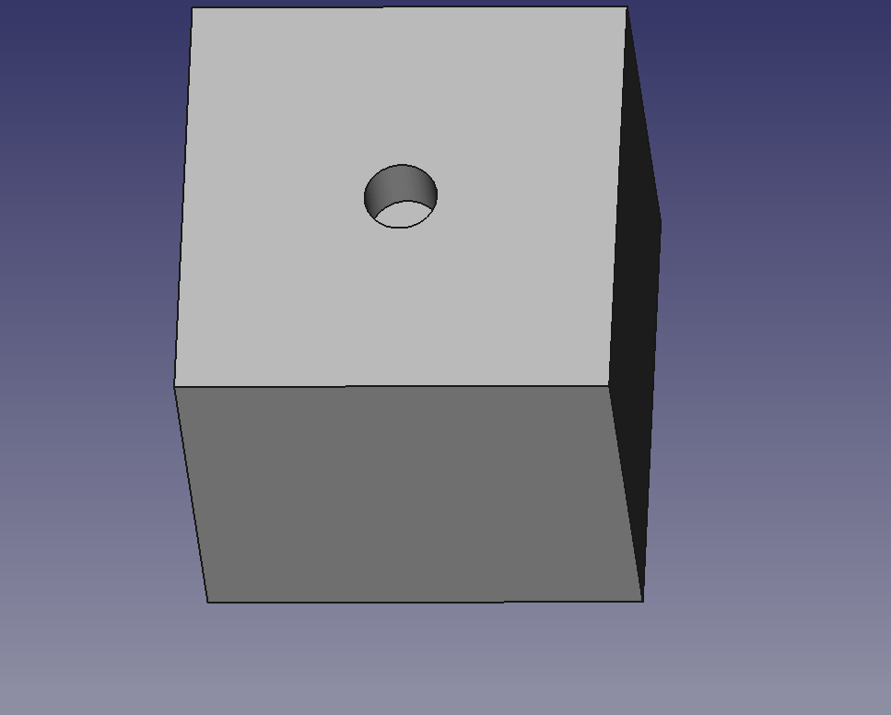
Parametric Modeling
Practice of assigning dimensional values from spreadsheet entries
Multiple dimensional values can be based on spreadsheet entry
Greatly accelerates prototyping process

Slide 12
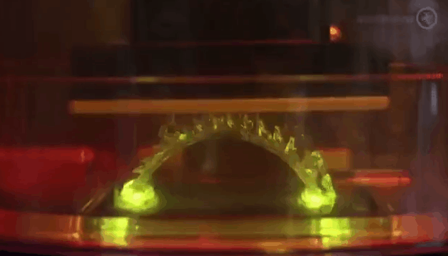
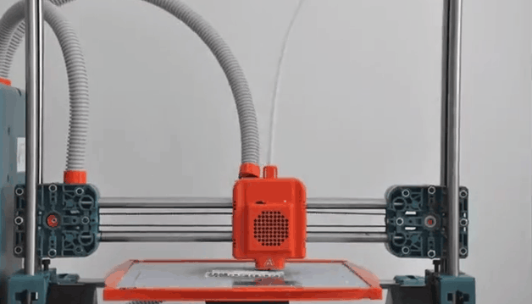
3D Printing Technology
Stereolithography (SLA)
UV cures resin
Undermount LCD panel patterns UV light
Fused Filament Fabrication (FFF)
Heats plastic filament until oozes
Extrudes oozing plastic through nozzle onto object
https://gfycat.com/healthyethicalafricanbushviper
https://gfycat.com/wilddescriptiveisabellineshrike

Slide 13
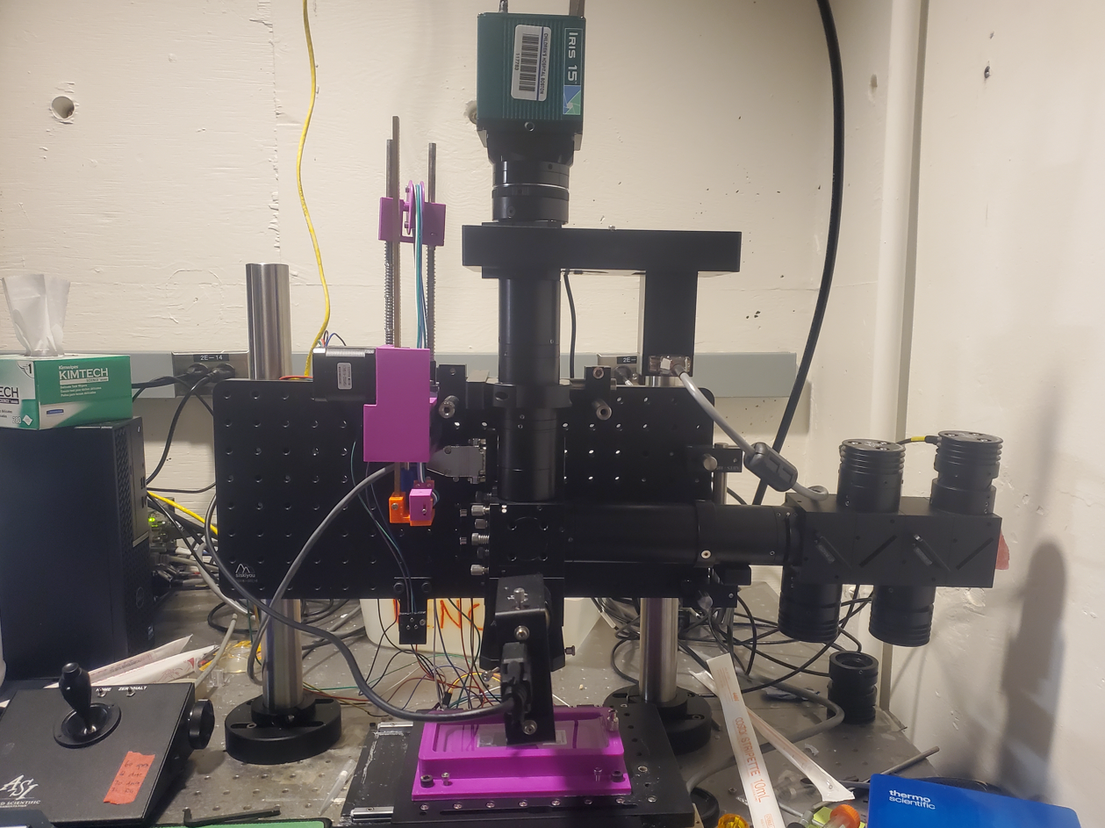
“Zoom” into objects in a cyclic fashion to show off features
Camera Chip Size (resolution, physical size, etc.)
Instage chamber
Pinch valve + multiplexor
Peristaltic pump

Slide 14
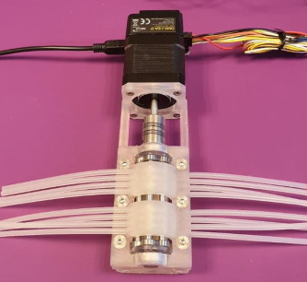
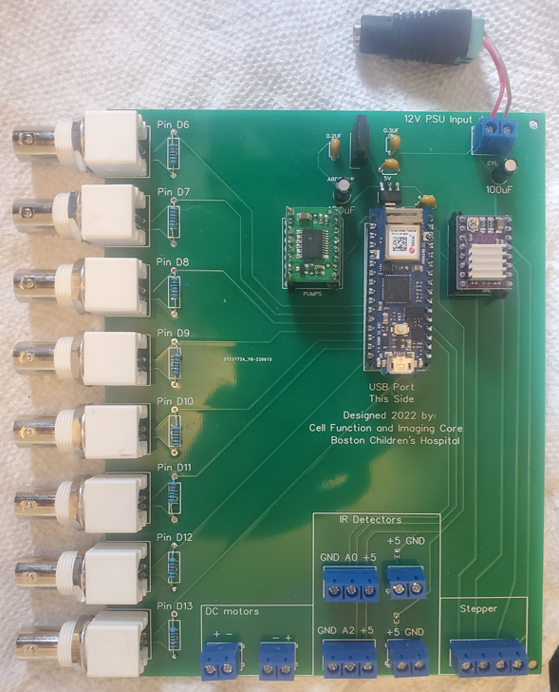
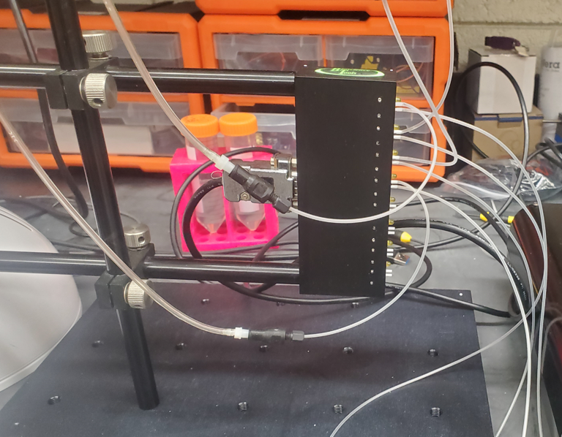
Software/Controllers

Slide 15
Invisi-Slip System
Fluid Flow
Objective
Fluid Flow
2500um
WD
FEP Film
1600um
100um Gap
Glass Slide (Tissue side up)
Smallish volume on top of entire slide surface (about 60uL)
No dilution of stain solution
FEP film has RI =1.333, PBS = 1.33, So if PBS is above and below the FEP film, it is effectively invisible
FEP film is a physical barrier, but not an optical barrier

Slide 16
File Format
DWG or DXF. DWG is a proprietary file format only for AutoCAD. DXF is the opensource equivalent.
Proprietary file formats are a scam and need to be discouraged to be developed. Use DXF!
While it appears initially that masks will have surfaces, don’t be alarmed that both DWG and DXF don’t have them. Its inherent in the design of those file types. They only save the borders. Don’t worry about making true surfaces due to this. Filling in enclosed surfaces or leaving them open is determined later in the software that generates the masks.
DWG File Format =
DXF File Format =
The world is now a better place due to the small, but powerful choice you just made.
“Gimmie all of those subscription fees”
-probably what this guy was thinking

Slide 17
FreeCAD Mode
Easy. Just make sketches. No need to extrude them too. Literally just bare sketches.
For organization, I recommend making bodies for each photomask which is done in part designer.
Huge tip. Make them parametric models.

Slide 18
Final device

Slide 19
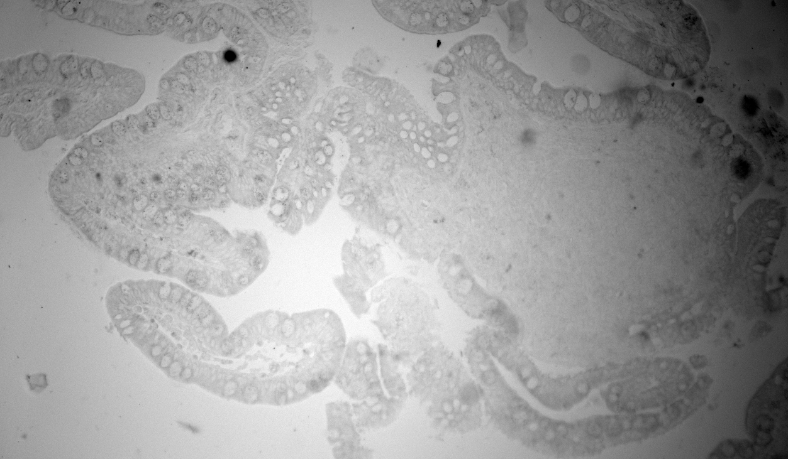
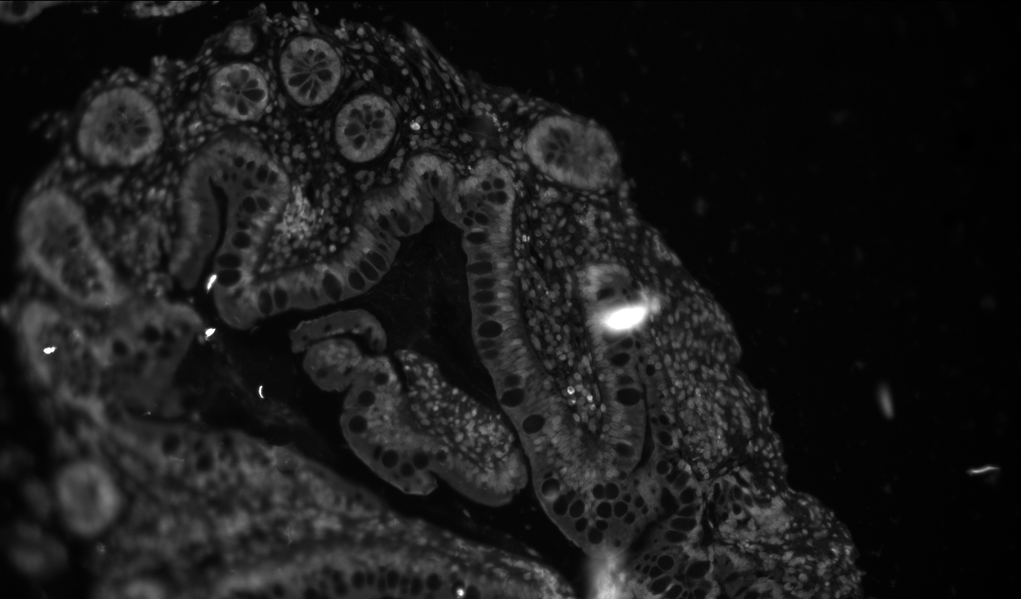
Reflection Issue
Image with 3D printed PLA housing behind slide. 2ms exposure (UV LED)
Image with blackened anodized Al dogtag behind slide. 1000ms exposure (UV LED)

Slide 20
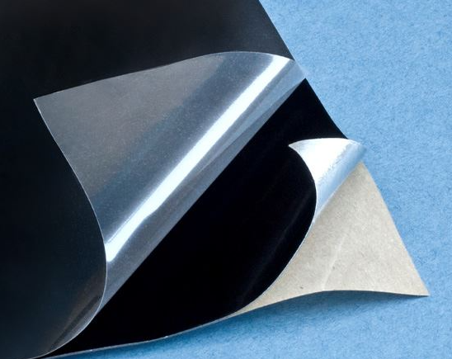
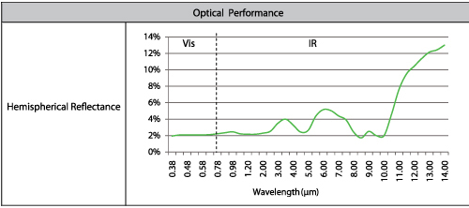
Anti-Reflective Solution

Slide 21
Auto Exposure vs Auto Focus: Chicken and Egg Problem
To auto focus properly, I must NOT have an over exposed image
To auto expose properly, I must be in focus
Picture is from: https://stevemouldey.com/2014/07/14/why-does-education-have-so-many-chicken-and-egg-arguments/

Slide 22
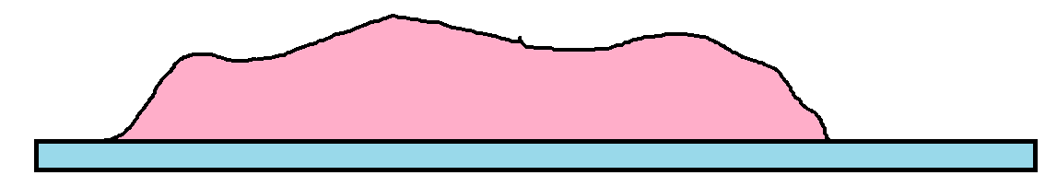
Solution
1. Scan over set Z range

Slide 23
Solution
2. Determine Relative Image Brightness Levels

Slide 24
Solution
3. Auto Expose on Brightest Z slice

Slide 25
Solution
4. Run Auto Focus over same range with determined exposure level

Slide 26
Solution
5. Run Auto Expose at in focus slice

Slide 27
First Order Decay graphs Alexa 488

Slide 28
Second Order Decay Graph Alexa 488

Slide 29
Bleaching Alexa 647
Prilezhaev
Reaction
Add peroxide
High pH
Epoxide
Alkene
Structure Alexa 647
Vicinal Diol

Slide 30
Discussion
Its obvious that mCPBA with A488 is a first order reaction, but it gains a second decay term between states of 1mM and 5mM. How could this be? Here is a hypothesis:
A488
+mCPBA
Chemically Altered A488
End Point Model
Fluor
Non-Fluor
This model cannot explain why second decay peak arises
I was told the reaction contained an intermediate though
A488
+mCPBA
A488 epoxide
+OH
A488 vicinal diol
Fluor
Non-Fluor?
Non-Fluor
Fluorescence is my reporter for the reaction. What is the Fluor of each state?

Slide 31
Discussion
Its obvious that mCPBA with A488 is a first order reaction, but it gains a second decay term between states of 1mM and 5mM. How could this be? Here is a hypothesis:
A488
+mCPBA
Chemically Altered A488
End Point Model
Fluor
Non-Fluor
This model cannot explain why second decay peak arises
I was told the reaction contained an intermediate though
A488
+mCPBA
A488 epoxide
+OH
A488 vicinal diol
Fluor
Partial Fluor
Non-Fluor
Fluorescence is my reporter for the reaction. What is the Fluor of each state?

Slide 32
Tau Chart
No Significant Bleach
No Significant Bleach
No Significant Bleach

Slide 33
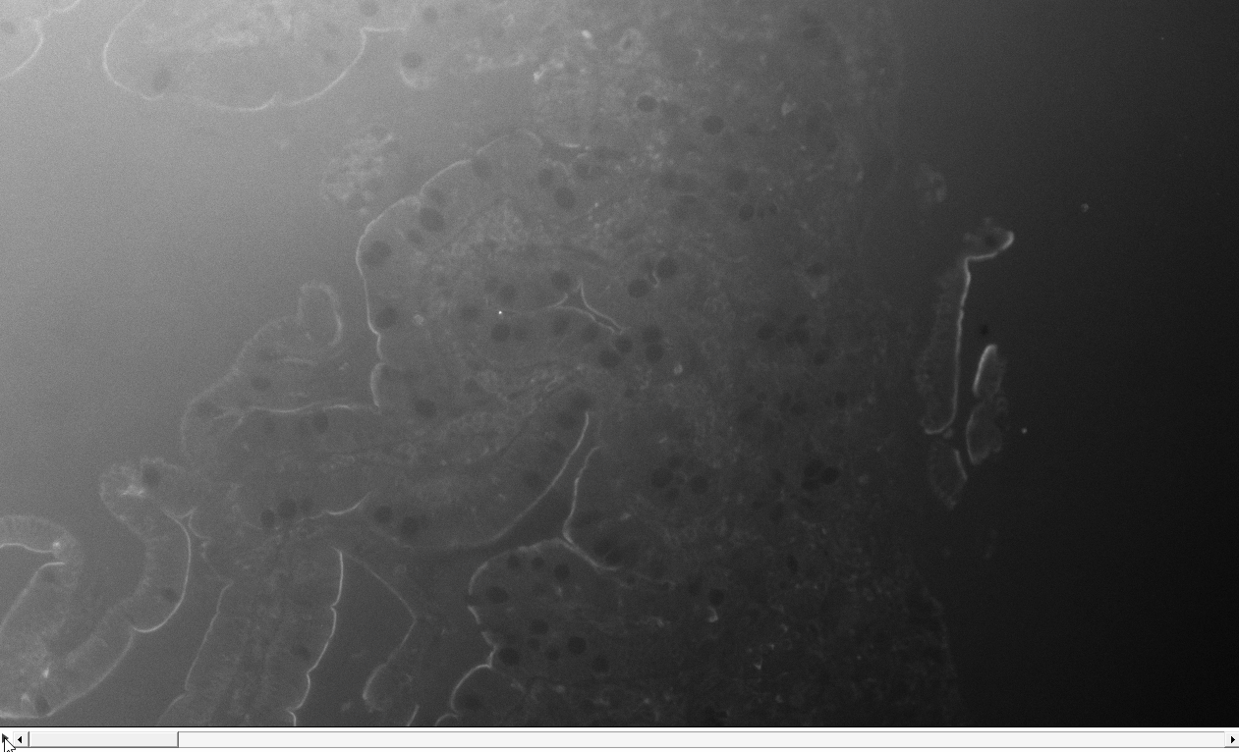
Direct Conj Cycle 1 Observations and Video
Image is of Alexa 647 Ezrin from 488 is leaking through.
Each frame is 5mins apart, 300ms exposure.

Slide 34
Time Lapse Int Graph
Stain Box
Background Box
37 minutes is not enough to approach plateau region. At most, 37 min is the start of that region. Not enough data to be confidence though.
Assuming uniform staining, S/N ratio is around 15 as intensity = 2200 and stdev = 150.

Slide 35
Time Lapse Int Rate Graph
Stain Box
Background Box
Binding kinetics is proportional to [antibody]*[epitopes]
If we assume antibody [C] is in such excess that its number negligibly changes over time, we can estimate % epitopes remaining and thus plateau signal.
Exp decay fit indicates 673 was the initial burst rate and ending rate was 111, that means 83% of epitopes were bound to. This supports initial stance that plateau region was being entered in the Int vs time graph.

Slide 36
Aggregated image final

Slide 37
Future
“Smart” focus algorithm. Focus on tissue, disregard junk, adapt to tissue being in multiple planes
New chamber with heating element, magnetic pressure plate and encased magnets.

